Slide 1
Gaming-Bets
An E-Sport App!
By André Helbig, Felix Morsbach
If E-Sport was easy, it would be called Soccer!

Slide 2
Agenda
Vision
Use Cases
Nonfunctional Requirements
Technical Architecture
Class Diagrams
Metrics
Demo
Project Team
Project Management
Risk Management
Lifecycle Management
Behavior Driven Development

Slide 3
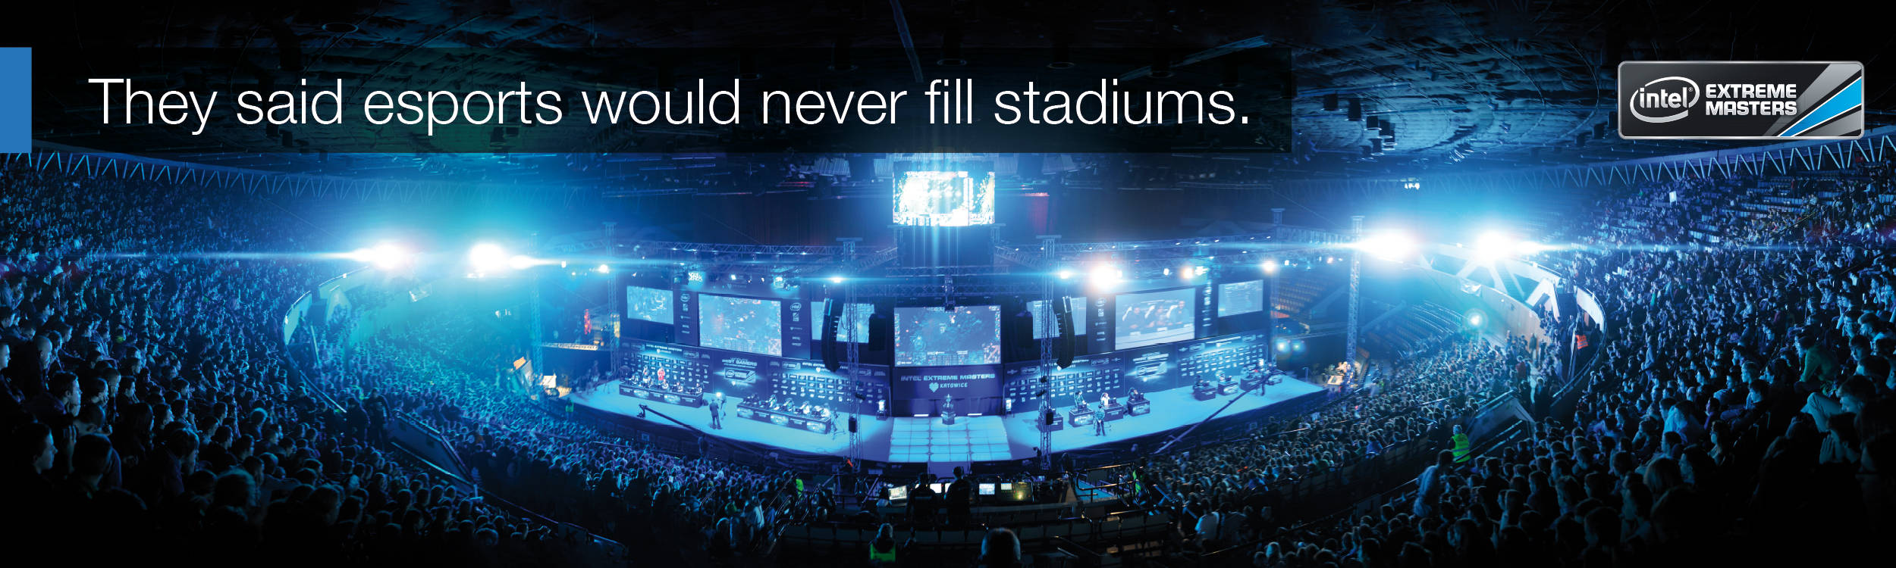
Vision!
We strive to be the best!!!
We love E-Sports!
We want to win!!

Slide 4
Open for MORE!

Slide 5
Nonfunctional Requirements
Easy to use
Available 24/7
Fast and up to date
Stability

Slide 6



Technical Architecture
http request
Repository Pattern (Java Persistence)
http response
Consists of
REST-Webservices
Microservices
Notes:
Easy to Replace Communication Typ!
Frameworks?

Slide 7
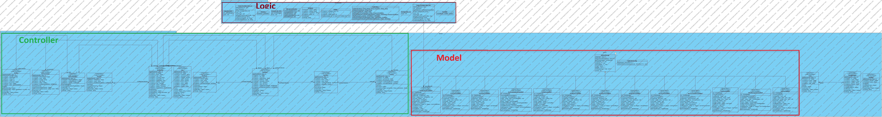
Class Diagram Sever

Slide 8
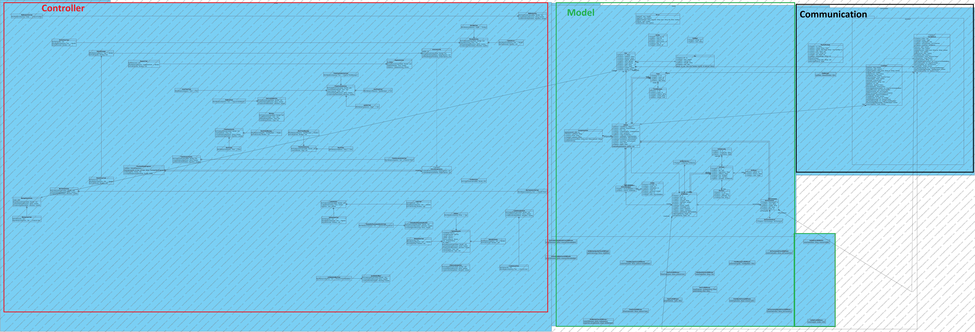
Class Diagram Client

Slide 9
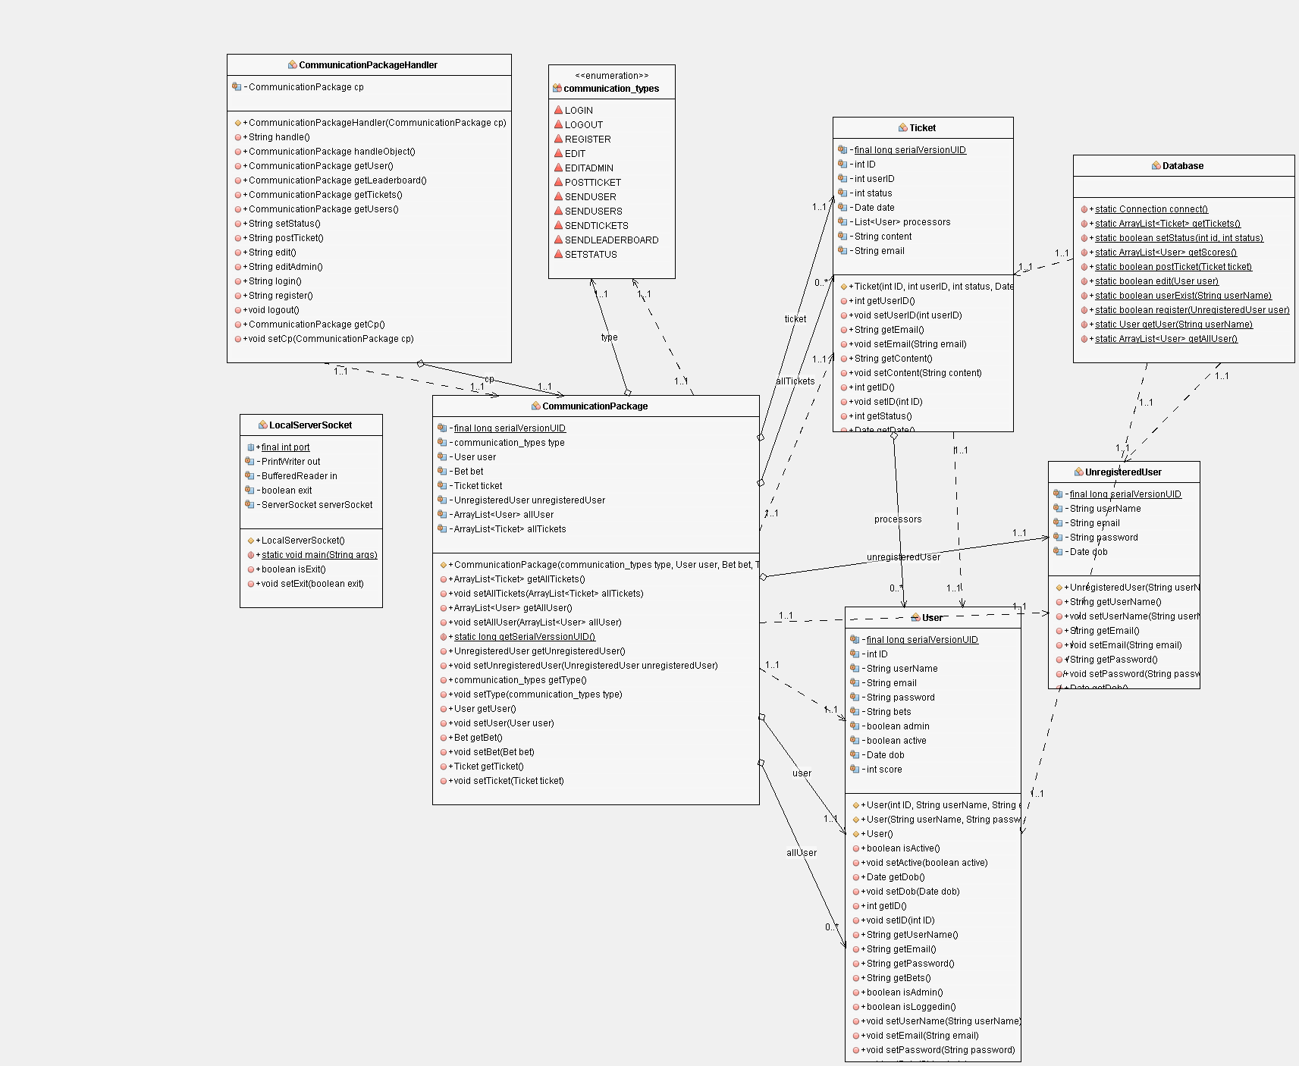
Pattern

Slide 10
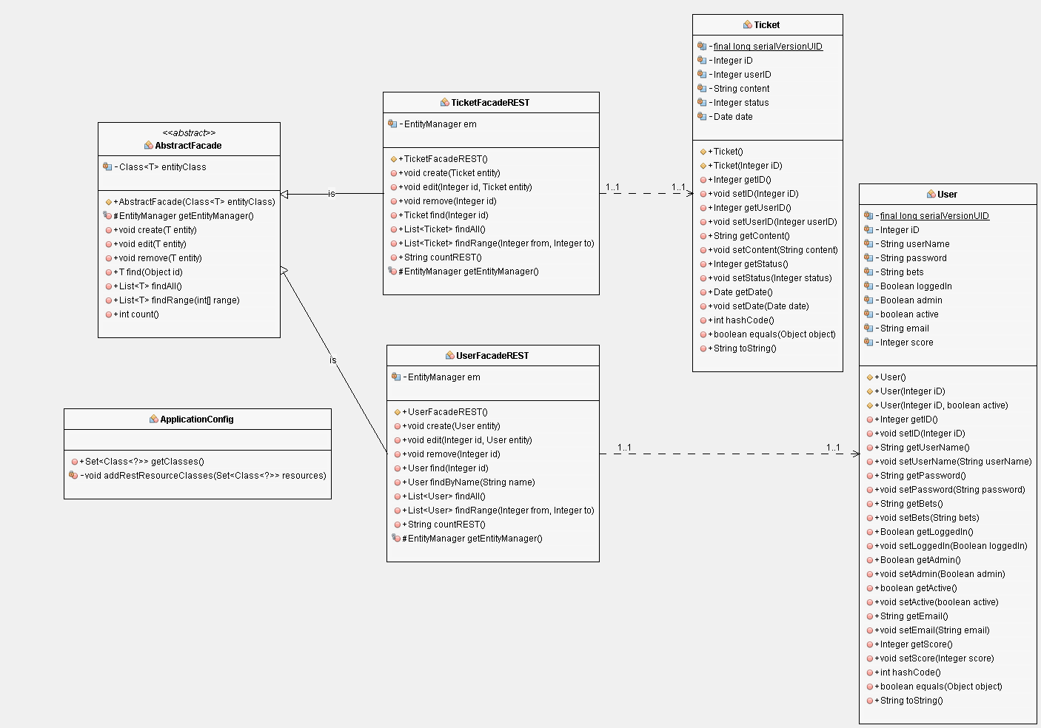
Pattern

Slide 11
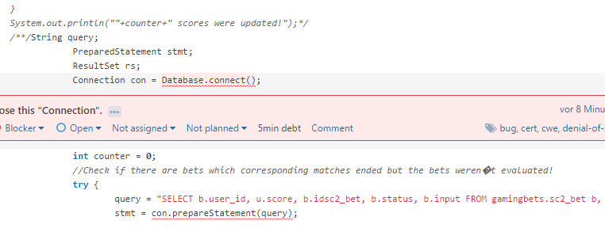
Metrics
Sonar Qube for code analysis to improve security and stability
Hardcoded db password
Close all mysql statements
Close all mysql connections

Slide 12
Demo
lets go?
Notes:
Link updated?

Slide 13
Project Team
Felix Morsbach: Project Manager, Test Manager, Implementer, Desinger
André Helbig: Integrator, Software Architect, Tester, Designer
Notes:
Lost Niclas Petersohn last Semester
Just two of us

Slide 14

Project Management
Jira as preferred platform
Optimal for Agile Developement
Statistics and Diagrams like a Burndown Chart
Iterative Process
Ready for YOUR Wishes!
Notes:
For short term Planning
Integrated jira into IDE (at least at some point in the past)
Automatically loging worktime
Meetings on a regular basis,
Regular scrum meeting,
Every two weeks sprint planning
WHY SCRUM?
Integrate Change requests in workflow
Client sees the product on a regular basis, not just 2 weeks before release

Slide 15
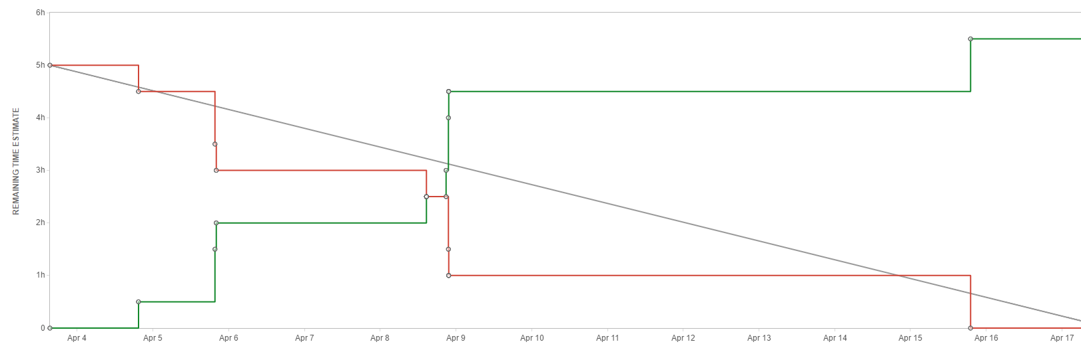
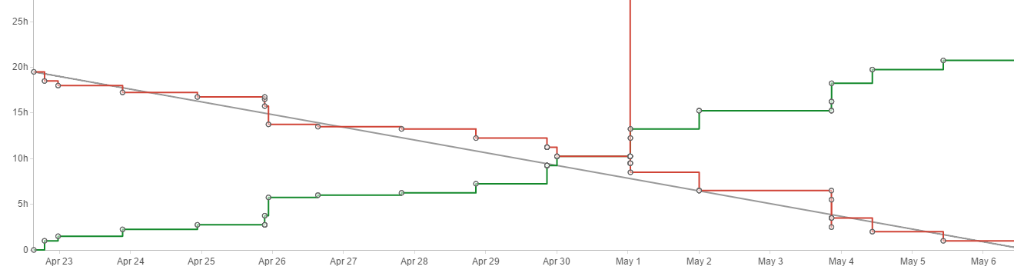
Project Management
Jira as preferred platform
Optimal for Agile Developement
Statistics and Diagrams like a Burndown Chart
Iterative Process
Ready for YOUR Wishes!
Notes:
Burndown Charts

Slide 16
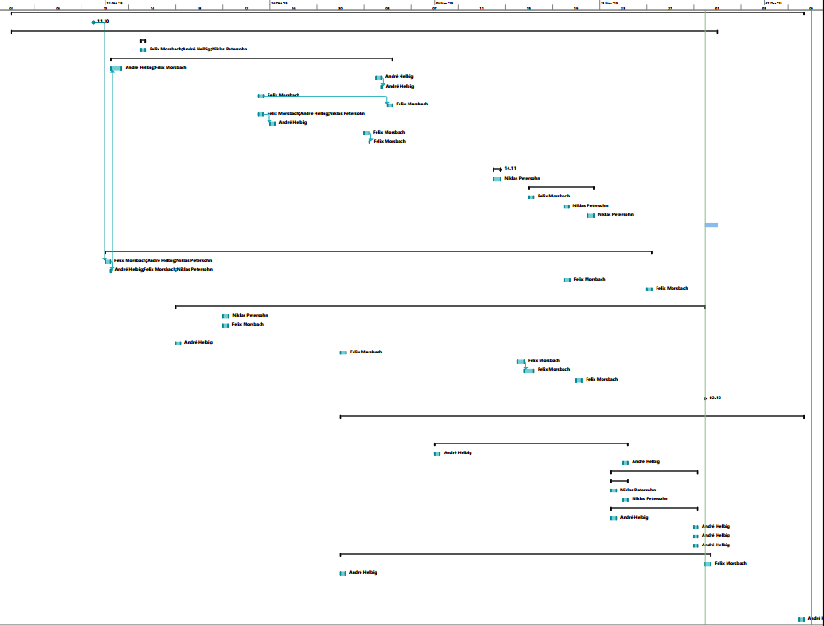
Gantt Chart
Logged worklog according to Issue/Subject
Results in a Gantt Chart of past activities
Notes:
Microsoft Project → generates Gantt chart
Keep a long term overview
Inspect Critical path
Results can be used to estimate workload in the future

Slide 17
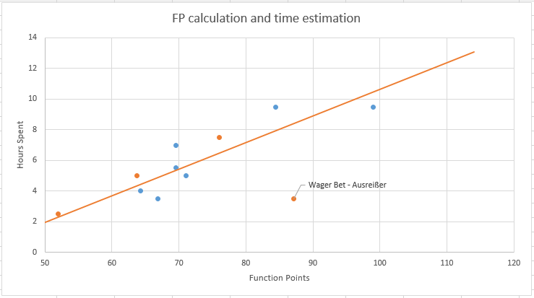
Check Game Results: 51,92 FP → 2,28h
Bet on Win: 76,5 FP → 6,47h
Wager Bet: 87,1 FP → 8,39h
Buy Reward: 63,7 FP → 4,32h
Notes:
FP Calculation according to hours spent
Blue dots are finished use cases from last semester
The Line approximates this data
-> based on this graph
-> approximate costs/time for future task
-> based on their FP
Click
UC describe
Click
Orange dot actual logged time
Suprisingly good estimation
Outlier / spike because of code reusage
At lot/Most work went to server sided logic and configuration, aswell as data base modelling

Slide 18
Risk Management
Active Risk Mitigation
Living document
Outline a Person in Charge for every Risk
Calculate Risk Factors
Risk probability * Risk Impact
Game data can not be fetched the regular way (reported: 13.05)
Mitigation: found multiple different API´s which can deliver same content (solved: 22.05)
Decrease risk probability → decrease risk factor
Notes:
We strive to use active….
Regular update so its a living document

Slide 19
Life Cylce Management
Versioncontrol with GitHub
IDE integration
Automated Build with each GitHub Push
Automated Test with every Build
Static Code Analysis and code coverage reports with every build
Automated deploy after succesful build to application server
Notes:
Badges on github as representation of actual status, can be embedded to other platforms aswell

Slide 20
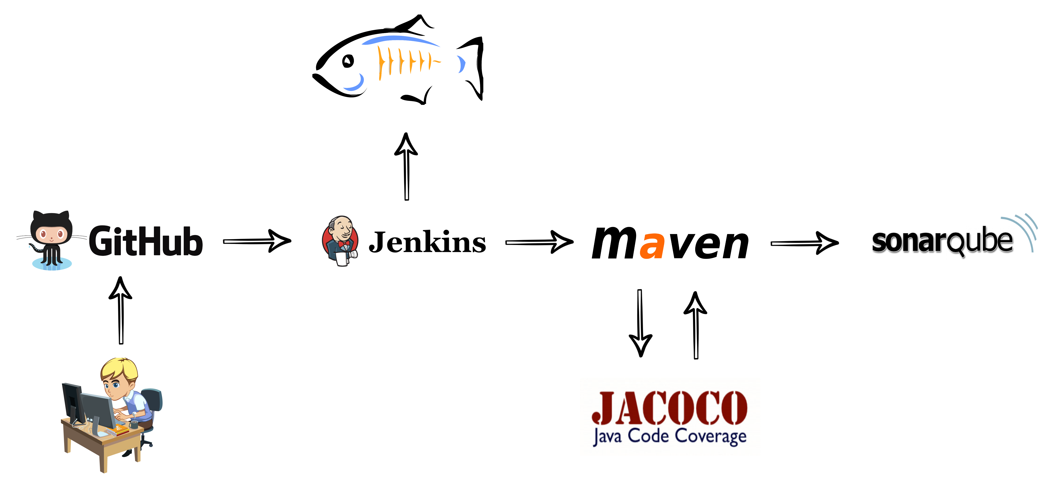

Slide 21
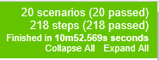
Behavior Driven Developement
Tests written in Gherkin
Easy to Use for non Programmers
Use predefined Steps!
Calabash for Android Testing
Reports
Notes:
To assure the behavior of your product is what you exected and wanted
Use BDD
Written in GHERKIN
Can add more steps if needed
Beatiful html.report

Slide 22
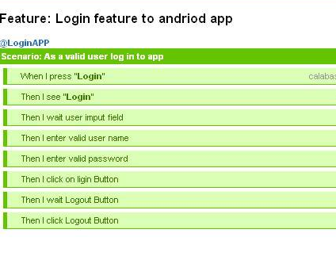
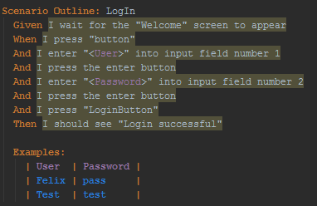
.feature File
Calabash
Report
Notes:
lets you express the behavior of your app using natural language that can be understood by business experts and non-technical QA staff.

Slide 23
Thanks for your attention, are there any questions left?

